Slide 1
Facebook Prophet Summary

Slide 2
Purpose: Prophet was originally designed to forecast time-series market data.
Seasonality that Prophet can capture: Yearly, weekly, and daily, hourly (Holiday can be captured by providing a manual list, weekend and non-weekend can be captured using conditional seasonalities).
Prophet needs a training dataset to train a model.
The data length of example training datasets are at least several years.
Inputs for training a Prophet model:
ds: YYYY-MM-DD for a date or YYYY-MM-DD HH:MM:SS.
y: numeric measurement.
Is it possible to add additional inputs? Yes, by add_regressor method.
Output of forecasting: yhat, yhat_lower, yhat_upper.
Can we include outliers when training? Yes, but the best way to handle outliers is to remove them (set values to NA).
Data Fusion: ?
Missing data recovery: yes.
Bad data detection: Probably not. (Bad data is recommended to be removed in the training dataset.)

Slide 3
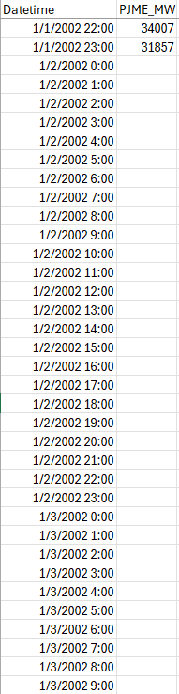
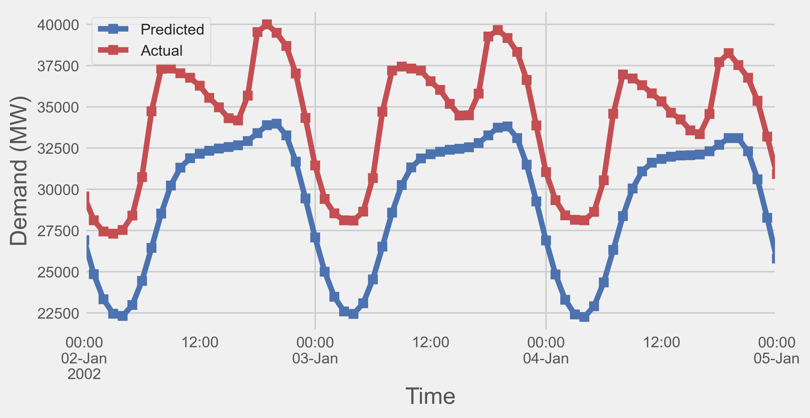
Missing Data Recovery:
Feed time stamps of those 3 days into a trained prophet model, we can get predicted values.
3-day missing data

Slide 4
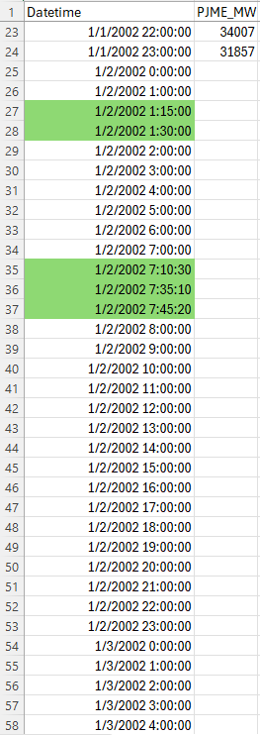
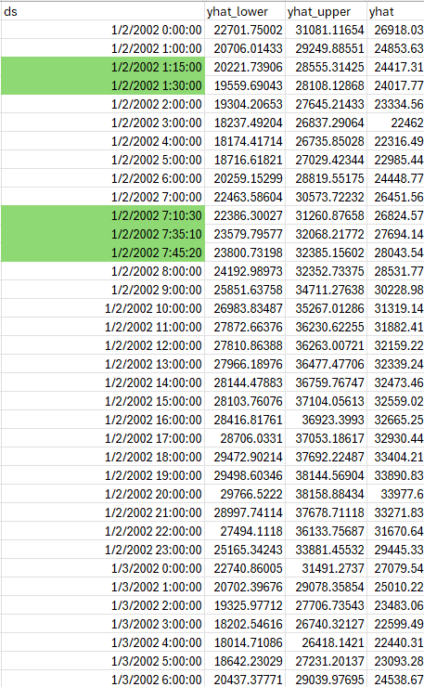
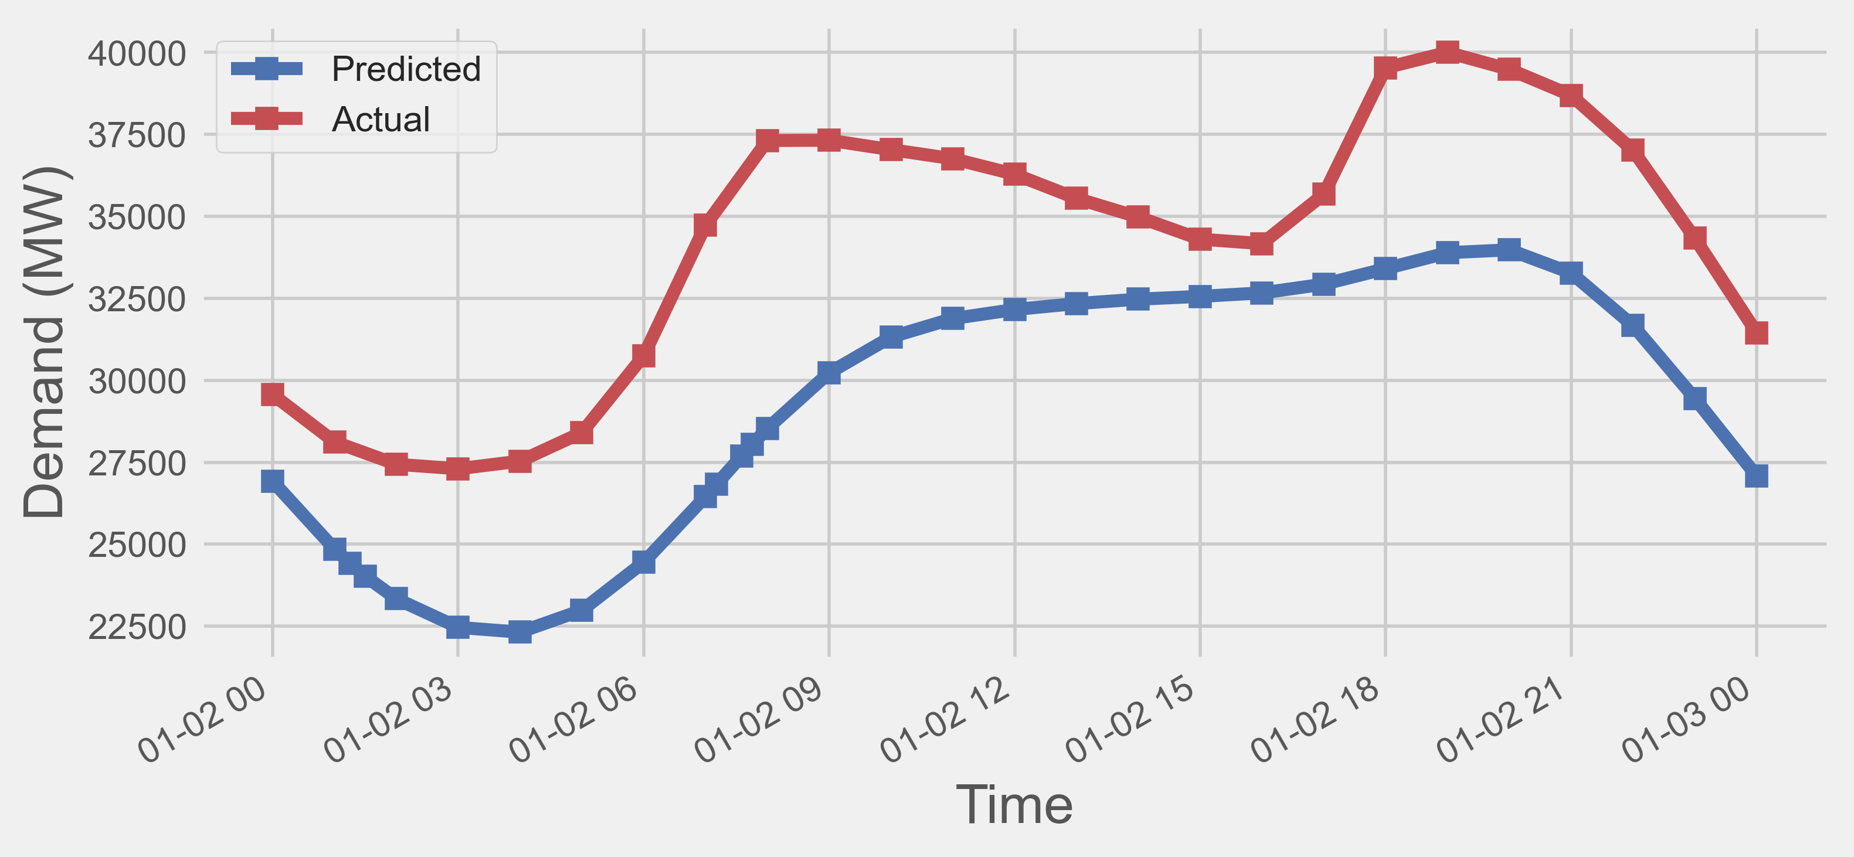
Data interpolation:
Manually added time stamps
Interpolated estimates

